Slide 1
Problem Identification
Current pricing strategy is to set a premium above the average ticket price for the market segment.
Management believes ticket prices for Big Mountain may be underpriced
Management wants advice on a better pricing strategy
There are also potential changes being considered to either justify an increased ticket price, or reduce costs without losing value leading to lower ticket prices
Current price of an adult weekend ticket = $81

Slide 2
Recommendation and Key Findings
Our model suggests a recommended price of $94.22 with an expected mean absolute error of $10.39
Recommend adding an additional run while extending vertical drop by 150 ft and adding an additional chairlift.
This would justify a $1.99 ticket increase, adding revenue worth more than double the additional costs
Recommend closing between 1-5 of the least popular runs depending on operating costs of those runs.

Slide 3
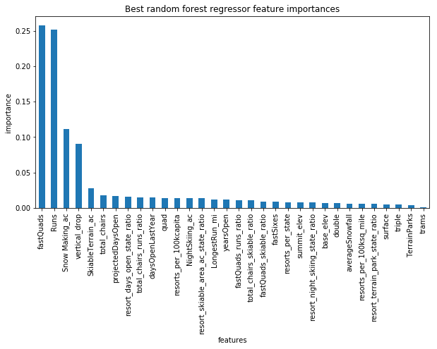
Modeling Results and Analysis
We determined the most important features to use to set ticket price
Big Mountain resort is near the top of all resorts in the sector for the most important features

Slide 4
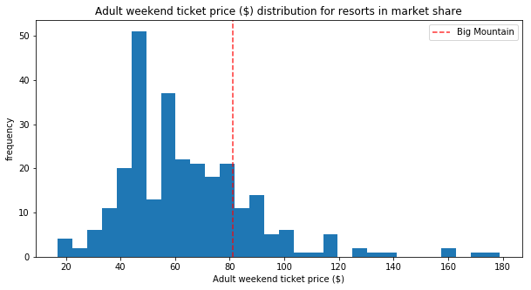
Modeling Results and Analysis
While Big Mountain has above average ticket prices, there are many resorts with higher prices.

Slide 5
Modeling Results and Analysis
Our model determined that adding an extra run, increasing vertical drop by 150, and installing a new chair lift to service the new run would increase the predicted ticket price by $1.99.
Assuming 350,000 visitors buying an average of 5 tickets each, this increases revenue for the season by $3,474,638
If the new lift costs the same to operate as the most recently installed one, this should more than cover the costs of both lifts

Slide 6
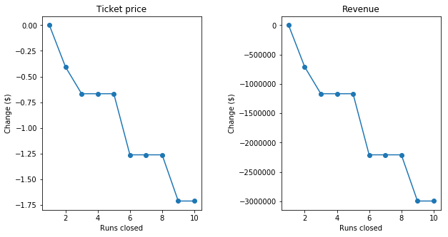
Modeling Results and Analysis
Closing the least popular run should have no effect on ticket prices
Closing the 2nd least popular run reduces ticket price by less than $0.50
Closing the 5 least popular runs reduces ticket price by less than $0.75

Slide 7
Summary and Conclusion
The predicted price should be $94.22 with a mean absolute error of $10.39
Adding a new run with increased vertical drop and a lift to service it increases the predicted ticket price by a further $1.99
The least popular run should be permanently closed and depending on operating expenses, so should the second through fifth least popular

